Slide 1

Challenge and Opportunity for HCV Elimination among Young PWID in New York City: Relatively Low RNA seroconversion and genetically linked HCV infections
Presenter: Pedro Mateu-Gelabert, Ph.D.
CUNY- Graduate School of Public Health & Health Policy
Co-Authors: H. Guarino, R. Almenana, E. Goodbody, C. Salvati.

Slide 2
HCV Infections among Young People Who Inject Drugs
A new generation of young people who inject drugs (YPWID) face persistent viral threats such as hepatitis C infection.
Young PWID tend to associate – and inject drugs – mostly with other drug users close to their own age group. However, despite this general tendency, a smaller proportion interacts with older PWID
Beyond HCV antibody prevalence, we need to know chronic infection rates and understand HCV transmission links.

Slide 3
Methods
As part of Staying Safe (Ssafe), an ongoing behavioral HCV-prevention intervention, we screened young opioid users (ages 18-29) in New York City, most of whom were referred by peers.
Between 2/8/18 and 12/12/19, we screened and collected DBS from 387 YPWID.Screening procedures included age verification, HCV antibody testing and Dried Blood Sample (DBS) collection.
DBS were sent to laboratory for RNA testing and GHOST (Global Hepatitis Outbreak and Surveillance Technology) phylogenetic analysis.

Slide 4
Results
Analysis of screening data indicated that 26% of screenees (101/387) were HCV Ab+, of whom 52% tested RNA+.
Fifty-two RNA+ samples were deemed viable (Ct <38) for GHOST phylogenetic analysis at the CDC.
27% (14/52) were genetically linked:
4 separate transmission links connected 4 pairs;
A 5th transmission link connected 3 individuals;
3 additional DBS were identified as “genetically close”.

Slide 5
HCV Ab+, RNA+ & Phylogenetic Links (n=387)

Slide 6
Ssafe Study Genotype Distribution (n=52)
Genotype | n | %
GT 1a | 34 | 65%
GT 2b | 1 | 2%
GT 3a | 16 | 31%
Mixed GT (1a,1b, 3a) | 1 | 2%
Total | 52 | 100%

Slide 7
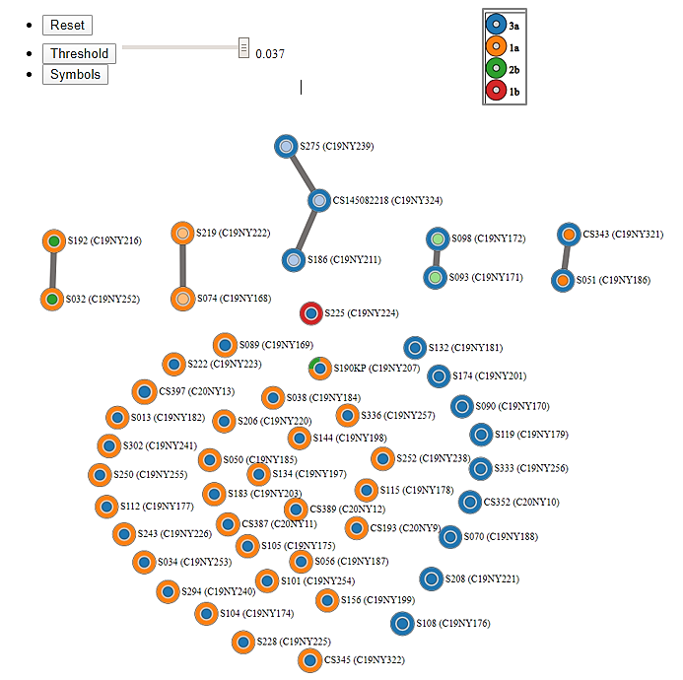
GHOST Network of Ssafe Study Samples

Slide 8
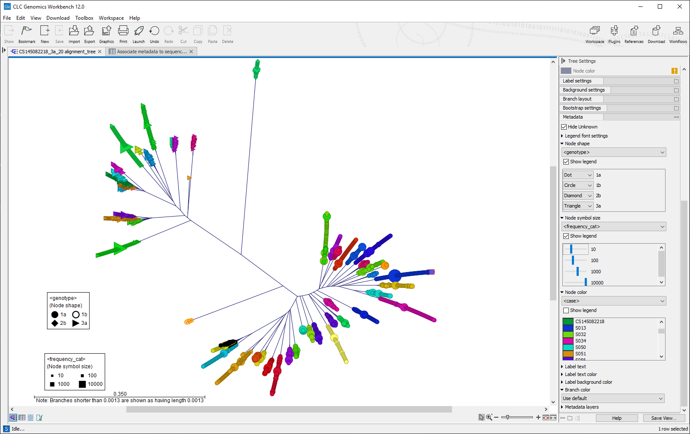
Phylogenetic Tree of All Cases
All cases, N_{haplotypes} =2577
Frequency= 20
Case appears close to the rest of the cluster, but is over the distance cut off for direct transmission. The sampling might be from high risk population.
S098
S093
S275
CS145082218
S186
S051
S032
CS343
S192
S074
S219

Slide 9
Conclusions
In a community sample of YPWID, a quarter of chronic HCV infections (i.e., RNA+) were genetically linked.
Phylogenetic testing could provide critical understanding of linked HCV infections and identify “hotspot” networks.
Expanding RNA testing and treating those with chronic infection could drastically reduce HCV incidence and transmission in the high-risk population of YPWID.

Slide 10
Acknowledgements
Thank you to all participants for their willingness to contribute to a study aimed at improving the health of people who inject drugs.
This research was supported by National Institute on Drug Abuse (NIDA) grant titled Staying Safe Intervention: Preventing HCV Among Youth Opioid Injectors (No. R01DA041501). The content is the sole responsibility of the authors and does not necessarily reflect the official views of NIDA or NIH.

